Slide 1
PowerShell and Puppet Enterprise API

Slide 2
What are we going to accomplish
Why use the puppet enterprise APIs
Show the advantages of using PowerShell with PE api’s
Talk about how you can improve your SR ranking in Overwatch

Slide 3
Thanks!
Jeremy Adams + Lizzi Lindboe
Puppet api round up from puppetconf 2015
Matt Cadorette
The best technical solutions engineer ! ( but I may be bias)

Slide 4
Why use PE api
Its consistent! …humans … not so much
Save the clicks!
Ok I admit it… I am totally Lazy

Slide 5
Some PE api enpoints ( more added all the time)
Status
RBAC
Orchestration
Puppet DB
Node Classifier

Slide 6

Status api

Slide 7

RBAC

Slide 8
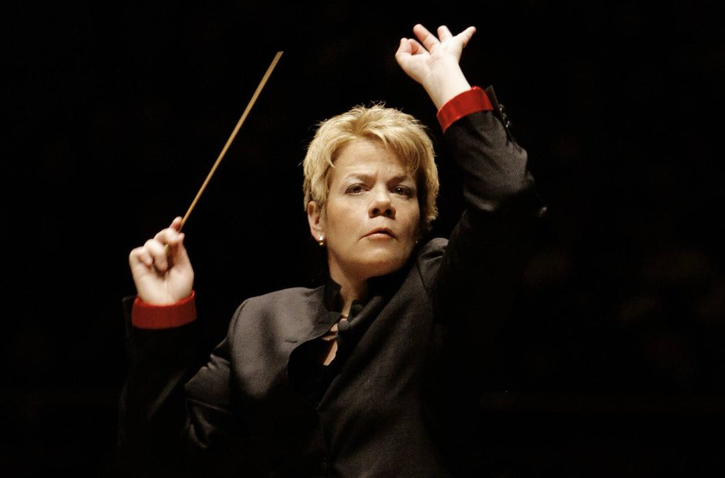
Orchestration

Slide 9
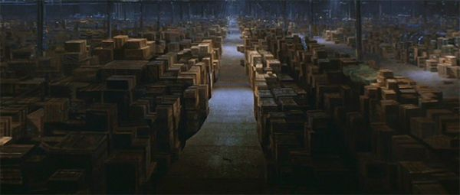
Puppet DB

Slide 10
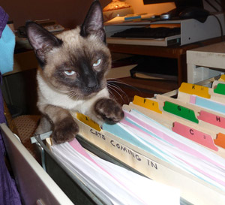
Node Classifer

Slide 11

Why use powershell

Slide 12
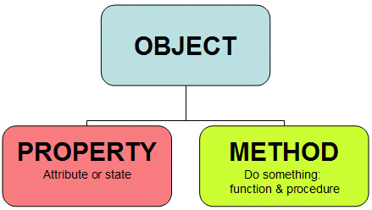
Objects!

Slide 13
Microsoft Backing

Slide 14
Open source

Slide 15
Command Discovery
Verb-noun
Get-command *rest*
( still looking for get-command *bourbon*)

Slide 16
Training

Slide 17
Dev Tools
VS Studio is cool
( ok its more cool than me.. But what isn’t )

Slide 18

Can be used my Mortals!

Slide 19
Ok but I still can do this in Curl

Slide 20
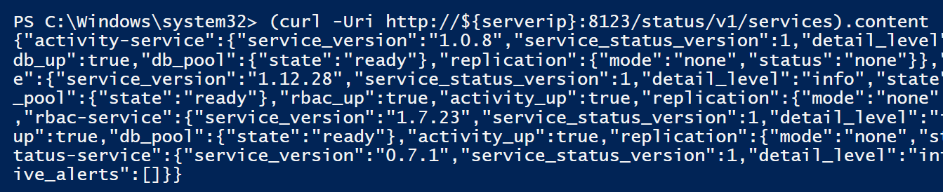
Is curl in powershell?

Slide 21
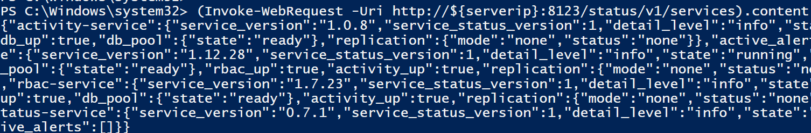
Is curl in powershell?

Slide 22
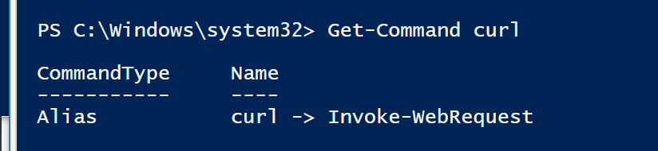
Whats up with that?

Slide 23
Yeah yeah but what about the client tools

Slide 24
What if you don’t really know what you want to do
Hold data in memory
Look at it
Filters
Tables
Where
Out-grid
Report it
export-csv

Slide 25
Example!

Slide 26
Are we working?

Slide 27
What about ssl?
Windows does not want you to do something bad so … add this ! [System.Net.ServicePointManager]::ServerCertificateValidationCallback = {$true}
Or you can import the ca into your trusted root

Slide 28
Stuff I had to learn!
Things are different in PowerShell .. Duh!
Check out http://wahlnetwork.com/2016/02/18/using-powershell-arrays-and-hashtables-with-json-formatting/’

Slide 29
Arrays
Json
{
“environments”: [
“production”
],
“wait”: “true”
yaml
---
environments:
- production
wait: ‘true’
Powershell
force_sync_body =@{
enviroments=@(“production”)
wait=“true”

Slide 30
Json syntax to PowerShell
 | Json | Powershell
Hash | {} | @{}
Array | [] | @()

Slide 31
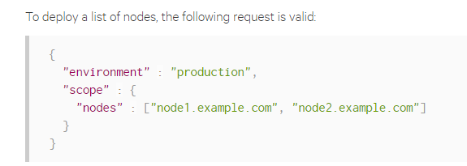
Example from puppet docs
Start a puppet job json body

Slide 32
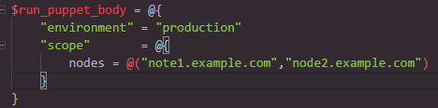
Same thing in PowerShell

Slide 33
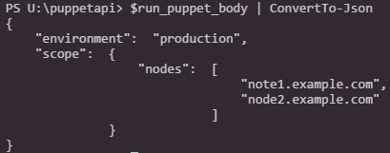
And after a quick switch

Slide 34
Tokens!

Slide 35
Force a job run

Slide 37
Exporting classifier to json

Slide 38
Db stuff

Slide 39
Questions?
samples at https://github.com/jgjohn02/puppetconf-2017

